Slide 1
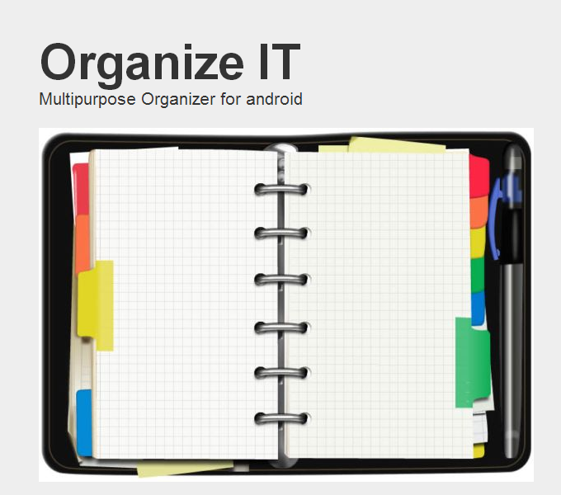
Multipurpose Organizer
Creator:
Nikolay Kolarov
November 2013

Slide 2
The idea
Organize items in a tree structure
Instruments
Clothes
Favorite Places
Friends
Family tree
Add notes
Save location
Add image

Slide 3




Project Setup
Server Side
C#
MSSQL Server 2012
Entity Framework
Web API HTTP services
Client Side
Java
Android SDK
Google Gson library

Slide 4

Server Side

Slide 5
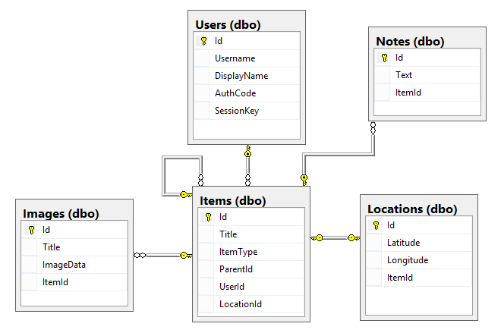
Database

Slide 6
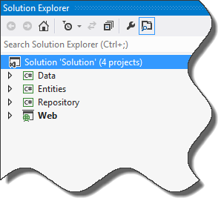
Database
Code First Approach
Entity Framework
Repository Pattern
Unit of Work

Slide 7
User Services
Login
Username
Authentication code
Register
Sign In (Register or Login)
username
display name
authentication code
Logout
session key

Slide 8
Items Services
all (full item model)
session key
all-compact (compact item model)
session key
for-parent
parentId
session key
details
elementID
session key
add
delete
update

Slide 9
Notes Services
Add
noteModel
sessionKey
Delete
id
sessionKey
Update
noteModel
sessionKey

Slide 10
Location Services
Set
itemId
locationModel
Latitude
Longitude
sessionKey
Delete
Id
sessionKey

Slide 11

Client Side

Slide 12

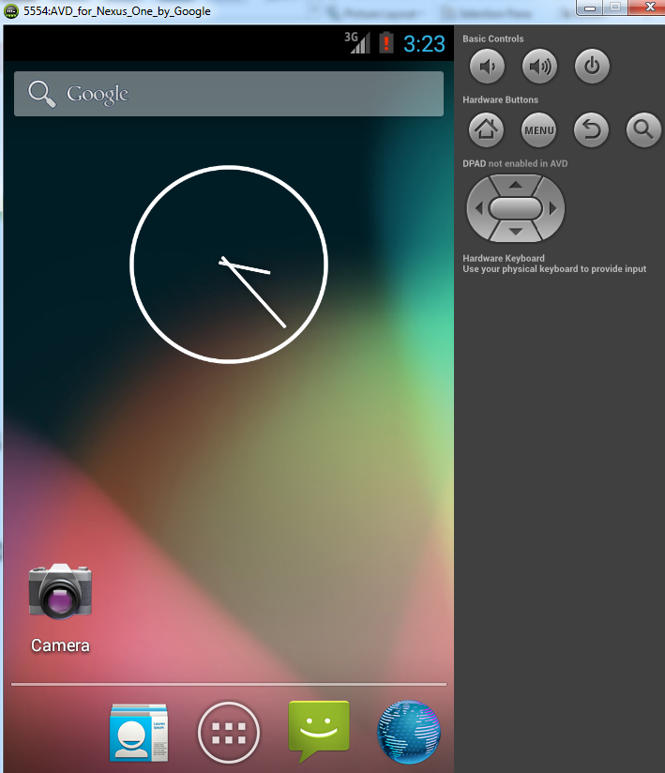
The Android Application
A lot of videos and tutorials
Blog articles
Many code samples
Android studio
Android virtual devices
Faster PC

Slide 13
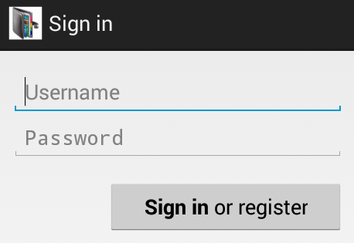
Entry point
Login Activity
Async UserLoginTask
Sign in
Register
Remember the user
Save user data in
application shared preferences

Slide 14
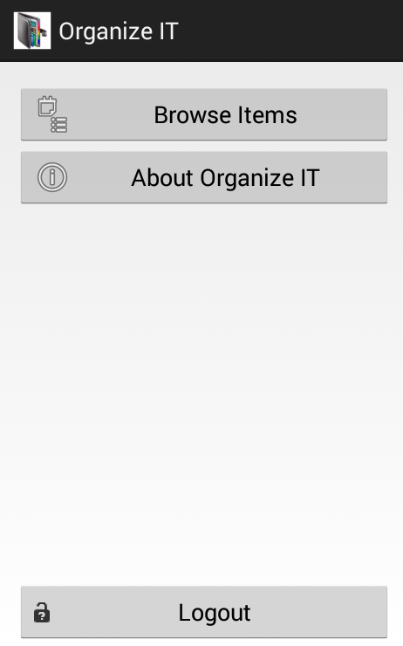
Main screen
Main Activity
Inner Placeholder fragment
Containing the main view
Handling Button Clicks
Launcher Activity
Checks user status and
redirect to login if needed.

Slide 15
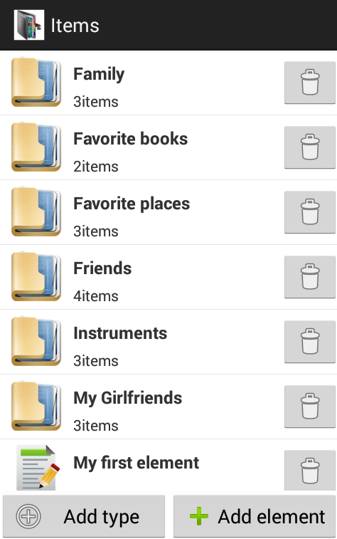
Items screen
Based on Master/detail flow
Item List Activity
onItemSelect redirects to
ItemDetailsActivity
Item List Fragment
Containing the item list view.
Save instance state
Handling button clicks

Slide 16
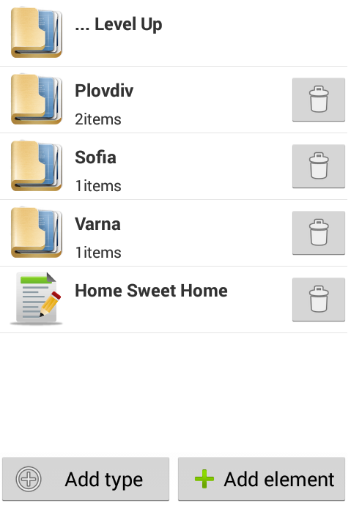
Items screen
Item List Adapter
Stores items
Inflates custom row view
Icon
Title and description
Delete button
Load Items Async task
Loads items from the web service
Delete Item task
Delete items from the list
Sync with the web service

Slide 17
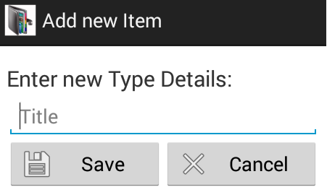
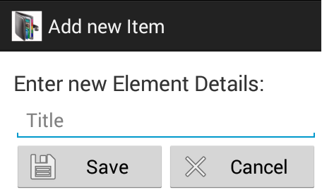
Add item screen
Add Item Activity
Inner Placeholder fragment
Receive a type as a message
Add type
Add element
Save Item Async task
Post the item to
the web service

Slide 18
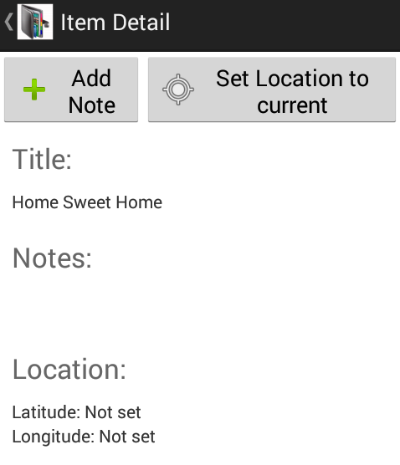
Item details screen
Item Detail Activity
Item Detail Fragment
Containing item details view
Handling buttons clicks
Get Item Details Task
Save Item Location Task
Add note activity

Slide 19
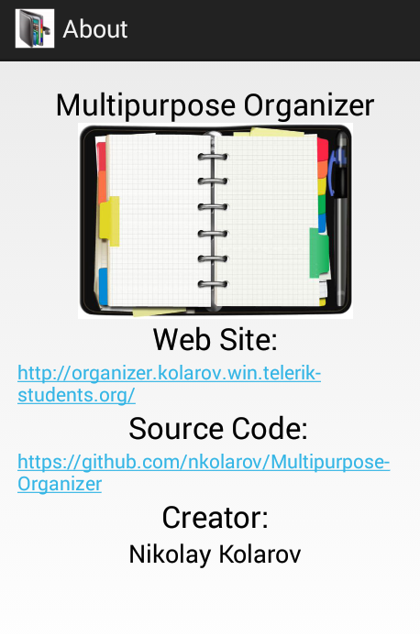
About screen

Slide 20
Helper Classes
HttpRequester
Get
GetMany
Post
Delete
MyLocation
getLocation
Get Location async task
GSON library
Serialize to JSON
Deserialize from JSON

Slide 21
Future improvements
Data caching (SQLite) and synchronizing.
Add photo functionality.
Breadcrumb navigation
Using the Action bar
Web site

Slide 22
Organizer Demo

Slide 23
Questions?

Slide 24
Thank you!

